Slide 1
Weekly report: Machine Bed & Yaw System
Week No - 7
Date: 11.11.2025
Supervisor: Prof. Peter Quell
Shoukat Abbas, Luksh Chawla, Sathishkumar Venkatachalam, Shrihari G Kadam
Presented by – Sathishkumar Venkatachalam

Slide 2
Contents
Yaw Bearing Selection & Details
Yaw Bearing Teeth Module
Yaw drive & its Motor specification
Bed Casting – New estimations
Sathishkumar Venkatachalam

Slide 3
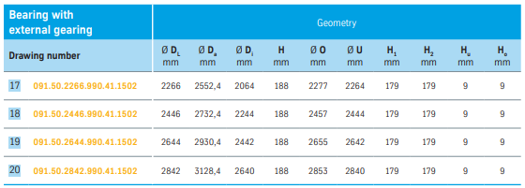
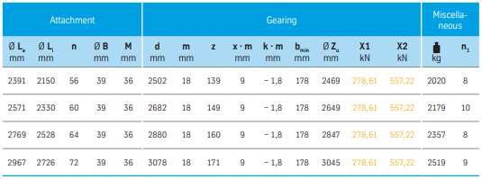
Yaw Bearing Selection & Details
1. Bearing Manufacturer - Thyssenkrupp Bearing
2. Bearing Type - Double-row four-point Bearing with External Gears
3. Manufacturer Dr. No: 091.50.2842.99041.1502 (20)
4. Value of Da is Ø3128,4mm and upscaling Da is app. 3903,9Ømm. Tolerance Safe Zone: 4000± 5mm
[4]
Sathishkumar Venkatachalam

Slide 4
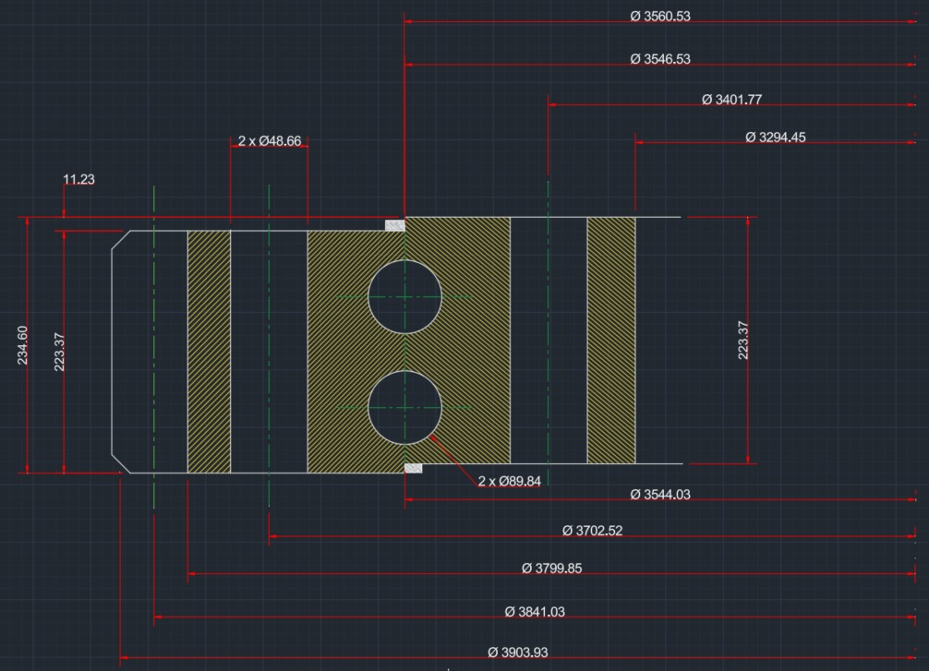
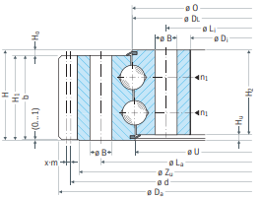
Yaw Bearing Selection & Details
[4]
Sathishkumar Venkatachalam

Slide 5
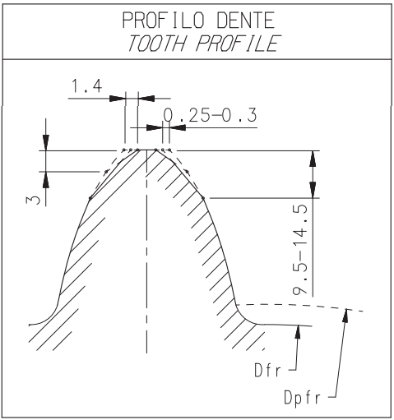
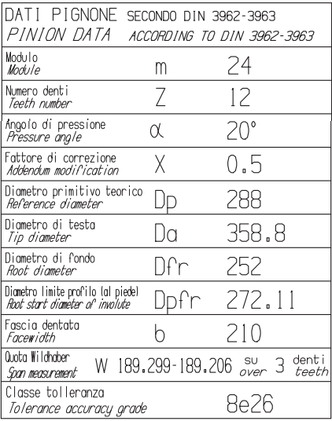
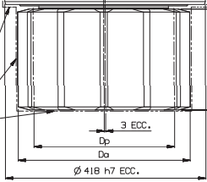
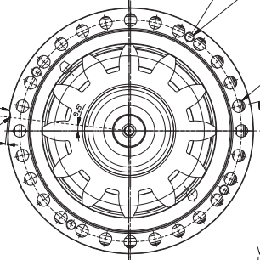
Yaw Bearing / Pinion Teeth Module
Source: provided by Bonfiglioli contact team on request.
Sathishkumar Venkatachalam

Slide 6
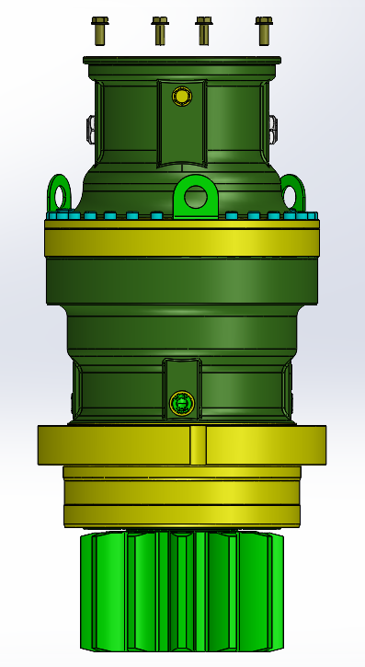
Yaw drive & its Motor specification
Specifications
Drive : Bonfiglioli 716 T4
Motor: BN160MR motor (11-15kW), 4 brake motor.
Gear Type: Planetary gear system for high torque and load capacity.
Torque: Capable of delivering rated torque up to 150,000 Nm and peak torque up to 400,000 Nm.
Benefit of 6 Drives: Distributes the load & ensures highly accurate directional control.
Gear System: Planetary Gear System - Durability - Excellent load capacity
Source: Bonfiglioli 716 T4
+ BN 160MR
Sathishkumar Venkatachalam

Slide 7
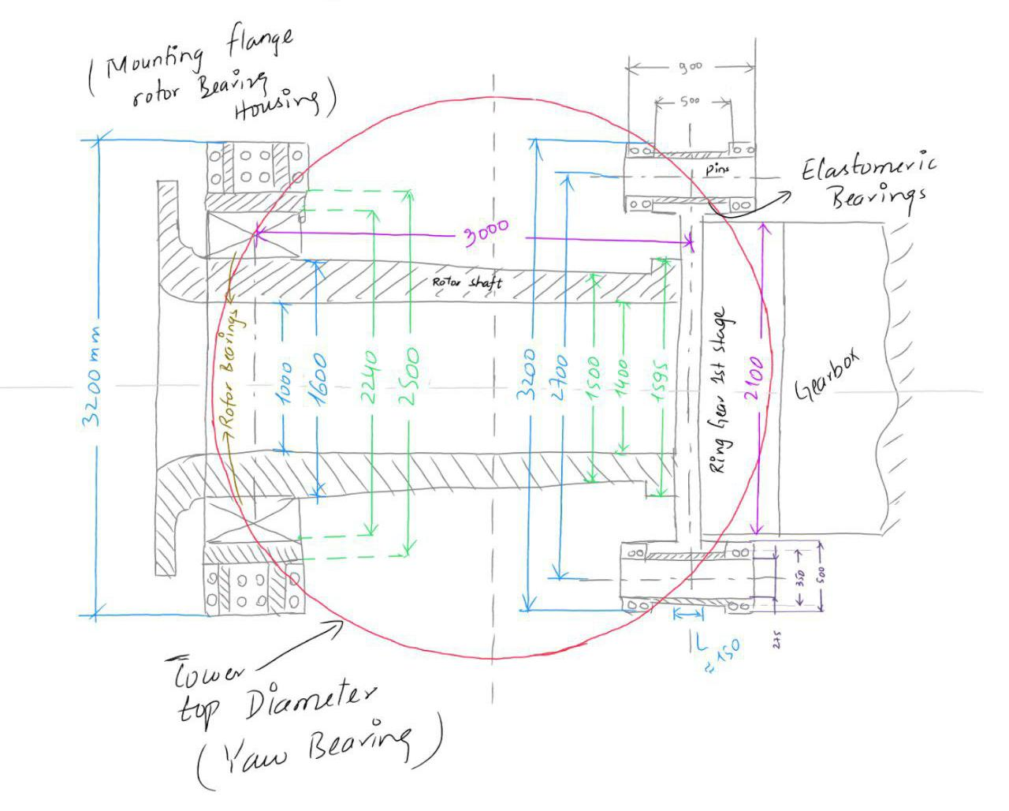
Bed Casting – New estimations
All dimensions are in mm.
Tower top diameter is 3800 mm
Sathishkumar Venkatachalam

Slide 8
References
[1]. Bonfiglioli (accessed 19 Oct 2025). Solutions for Wind. https://www.bonfiglioli.com/_default_upload_bucket/TR_CAT_WIND_STD_ENG_R05_0.pdf
[2]. WEC Development Project: Optimus Shakti 5.0 Machine Bed and Yaw System Final Report.
[3]. Master Wind Engineering Project Optimus 92LE Machine Bed and Yaw System
[4]. Thyssenkrupp bearing Catalogue – (accessed 23 oct 2025). https://ucpcdn.thyssenkrupp.com/_binary/UCPthyssenkruppBACTBearing/de/downloads/link-thyssenkrupp_rothe_erde_bearing_inspection.pdf
Sathishkumar Venkatachalam

